Slide 1


EcoPrompt: Inspiring Sustainability Through AI-Generated Prompts
Team Members:
Athiraj V.S (2020115016),
Siva Vignesh S (2020115086),
Someshwar J (2020115088)
Under the Guidance of
Dr. M. Deivamani, Assistant Professor.

Slide 2
Problem Statement
The carbon footprint of AI is affected by the complexity of its tasks.
This project focuses on creating a Prompt Generation Model (PGM) for image generation, aiming to convert user inputs into efficient prompts.
The goal is to reduce the computational workload of the LLM while maintaining image quality and relevance.

Slide 3
Literature Survey
Sno | Title | Journal/Conference | Methodologies/approaches | Pros | Cons
[1] | Graph of Thoughts: Solving Elaborate Problems with Large Language Models | CHI Conference on Human Factors in Computing Systems Extended Abstracts (2023) | Graph of thoughts | Efficient decomposition, versatile graph transformations. | Context limitation, learning curve.
[2] | Beyond Chain-of-Thought, Effective Graph-of-Thought Reasoning in Large Language Models | Advances in Neural Information Processing Systems 31: Annual Conference on Neural Information Processing Systems (2023) | Graph of thoughts, Chain Of Thought | Realistic thought modeling. Complex reasoning. | Novelty, task-dependence.
[3] | DreamStyler: Paint by Style Inversion with Text-to-Image Diffusion Models | Proceedings of the IEEE/CVF Conference on Computer Vision and Pattern Recognition (2023) | Text to Image synthesis and style transfer | Flexibility to accommodate a range of style references, the avoidance of overfitting. | limitations within the intricate context of artistic expression

Slide 4
Literature Survey
Sno | Title | Journal/Conference | Methodologies/approaches | Pros | Cons
[4] | Deliberate Problem Solving with Large Language Models | Proceedings of the ACM/IEEE International Symposium on Computer Architecture, (2023) | Tree of thoughts | Generality Modularity Adaptability Convenience | LM Quality Resource Intensive
[5] | Multimodal Chain-of-Thought Reasoning in Language Models | Proceedings of 2021 Conference of the Association for Computational Linguistics (ACL) (2023) | Multimodal Chain-of-Thought Reasoning | Multimodal approach and generate better rationales for answer inference | Limited Context Integration
[6] | Pre-trained Language Model with Prompts for Temporal Knowledge Graph Completion | CHI Conference on Human Factors in Computing Systems Extended Abstracts (2023) | Re-trained Language Model with Prompts for TKGC | Improved TKGC accuracy | Limited Temporal Awareness, Insufficient Contextualization

Slide 5
Literature Survey
Sno | Title | Journal/Conference | Methodologies/approaches | Pros | Cons
[7] | Natural Language is All a Graph Needs | Proceedings of the IEEE conference on computer vision and pattern recognition (2023) | InstructGLM that uses natural language instructions to fine-tune a large language model for graph learning | Fine-tune a large language model for graph learning include its simplicity, efficiency, and scalability, | Handling complex graph structures and the need for further validation on larger datasets.
[8] | DreamBooth: Fine Tuning Text-to-Image Diffusion Models for Subject-Driven Generation | Proceedings of the IEEE conference on computer vision and pattern recognition (2023) | Subject-driven generation, which allows users to synthesize novel renditions of a subject based on personalized generative priors | Ability to generate personalized images of a subject in different contexts | Difficulty in controlling fine-grained details of subject appearance using prompts

Slide 6
Literature Survey
Sno | Title | Journal/Conference | Methodologies/approaches | Pros | Cons
[9] | Prompt Tuning for Graph Neural Networks | Conference paper at ICLR (2022) | Graph Prompt | Efficient adaptation method | Missing Evaluation
[10] | Self-Consistency improves chain of thought reasoning in language models | Conference paper at ICLR (2022) | Self-consistency method, Chain-of-thought prompting | Improves accuracy significantly and provides rationales and uncertainty estimates | Language models can generate incorrect or nonsensical reasoning paths
[11] | P-Tuning v2: Prompt Tuning Can Be Comparable to Fine-tuning Universally Across Scales and Tasks | International Conference on Machine Learning (ICML) (2022) | Prompt Tuning, empirical analysis. | Universality, Simplicity, and reduced training time and memory cost compared to fine-tuning. | Performance trade-offs. Limited adoption. Complexity.

Slide 7
Literature Survey
Sno | Title | Journal/Conference | Methodologies/approaches | Pros | Cons
[12] | Sustainable AI: Environmental Implications, Challenges and opportunities | Proceedings of the ACM/IEEE International Symposium on Computer Architecture (2021) | Holistic analysis. Cycle, footprint. Opportunities, development. | Carbon reduction, savings, perception. | Performance trade-offs. Limited adoption. Complexity.
[13] | Putting Humans in the Natural Language Processing Loop: A Survey | Conference on Empirical Methods in Natural Language Processing and the International Joint Conference on Natural Language Processing (2021) | Active learning, Crowdsourcing, Interactive machine learning | Performance Boost Interpretability Bias Mitigation Collaboration | Time & Cost Feedback Quality Feedback Bias
[14] | The Future is Big Graphs! A Community View on Graph Processing Systems | Communications of the ACM journal (2020) | Model Checking Theorem Proving Indexing Sampling Reproducibility | Complex Data Handling Relationship Insights Versatile Applications | Computational Cost Scalability Challenges Expertise Required

Slide 8
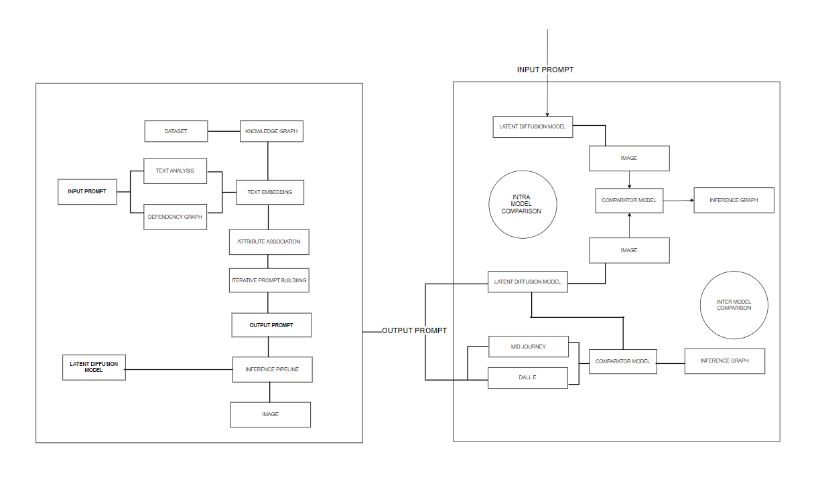
Architecture

Slide 9
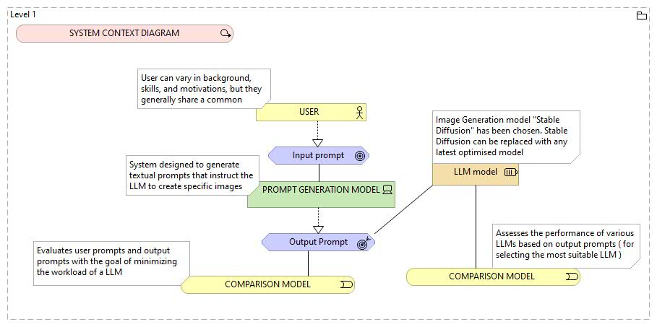
Detailed Architecture
System Context Diagram: People and software systems that are directly connected to the software system in scope.

Slide 10
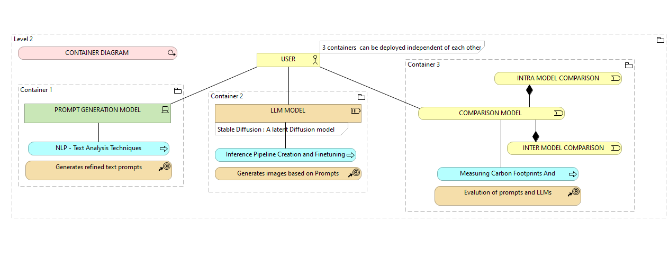
Detailed Architecture [Contd.]
Container Diagram: A container is a separately runnable/deployable unit (e.g. a separate process space) that executes code or stores data.

Slide 11
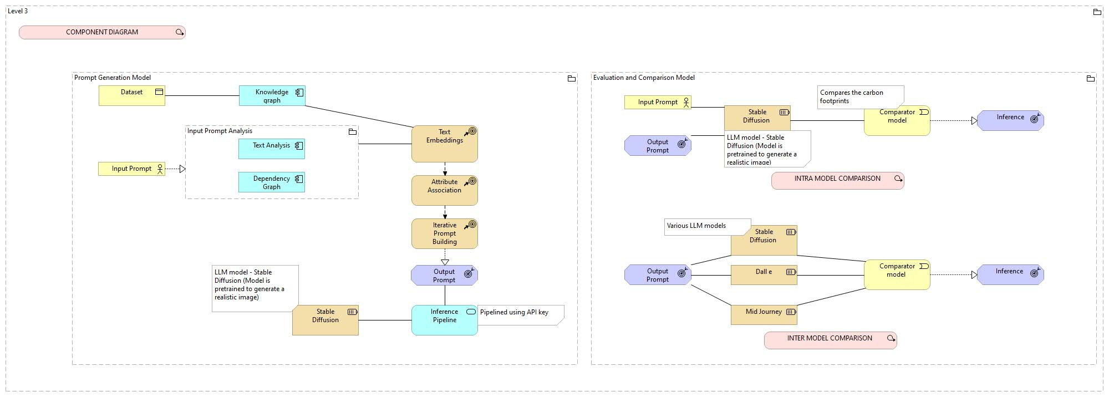
Detailed Architecture [Contd.]
Component Diagram: Decompose each container further to identify the major structural building blocks and their interactions.

Slide 12
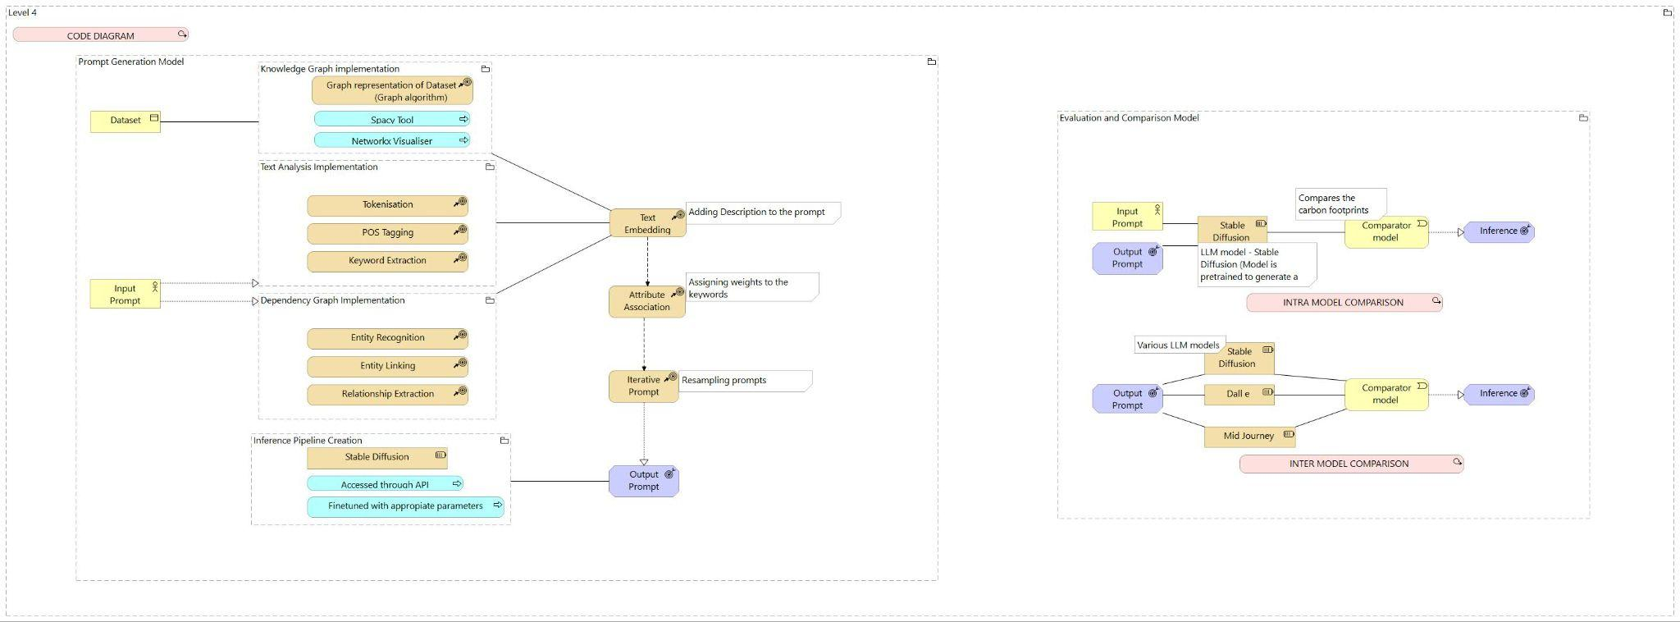
Detailed Architecture [Contd.]
Code Diagram: zoom in to each component to show how it is implemented as code

Slide 13
Choice of LLM
Stable Diffusion is a latent text-to-image diffusion model capable of generating photo-realistic images.
Latent diffusion can reduce the memory and compute complexity by applying the diffusion process over a lower dimensional latent space, instead of using the actual pixel space.
Inference Pipeline with Stable Diffusion: Demostration Link

Slide 14
Detailed Module Description
Prompt Generation Model
LLM Model
Intra Comparison Model
Prompt Model Fine-tuning
Evaluation Model
Inter Comparison Model
PHASE 1
PHASE 2

Slide 15
Detailed Module Description [Contd.]
Prompt Generation Model:
Knowledge Graph Generation
Input Prompt Analysis
Text Embedding
Attribute Association
Iterative Prompt Building
LLM Model:
Inference Pipeline Creation

Slide 16
Prompt Generation Model
Knowledge Graph Generation
Identifies a specific entity from a predefined knowledge graph, and generates a subgraph that highlights relationships associated with that identified entity.
Input Prompt Analysis
Tokenize the input sentence and extracts the important keywords, assign the Parts of the Speech tag to each token.

Slide 17
Prompt Generation Model [Contd.]
Text Embedding
Adding the additional description to the user input prompt from the Knowledge Graph, and generates more contextual output prompts.
Attribute Association
Based on the Dependency Graph, the weights will be assigned the keywords of the user input prompt.

Slide 18
Prompt Generation Model [Contd.]
Iterative Prompt Building
From all the output generated prompts, most meaningful prompts will be returned based on the cosine similarity score.
LLM Model
Inference Pipeline Creation
Create a pipeline to Stable Diffusion and access to API to generate the image using user prompt and generated prompt.

Slide 19
Algorithm and Pseudo Code
Prompt Generation Model
GitHub Link: Click Here
Get prompt from the user - user input prompt
Extract the keywords - Tokenization
Perform POS tagging - Subject Identification
Prediction of sentiment of the user input prompt
Implementation of Dependency Graph for user input prompt

Slide 20
Algorithm and Pseudo Code [Contd.]
Implementation of Knowledge Graph for dataset
Text Embeddings and Attribute Association to subject of the user input prompt
Adding descriptive details to the user input prompt - Anatomy of Good Prompt

Slide 21
Anatomy of Good Prompt
Subject
Medium
Style
Artist
Resolution
Color
Lighting
Iterative prompt building
Keyword weight
Keyword blending

Slide 22

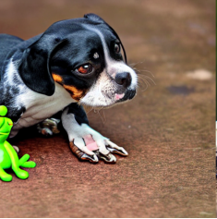
Comparison
User Input Prompt: “ Dog and Frog are playing ”

Slide 23
User Input Prompt
POS Tagging
Subject Description
Frog
( Subject )
Tropical Frog
and
( C.C)
and
Background inclusion
&
Weight Inclusion
Frog and Dog are playing
Dog
Cute Dog
( Subject )
are
are
( VBP)
playing
playing
( verb )
Tropical Frog ++
and
Cute Dog ++
are
playing
in the rainforest

Slide 24
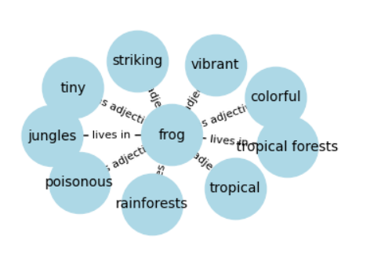
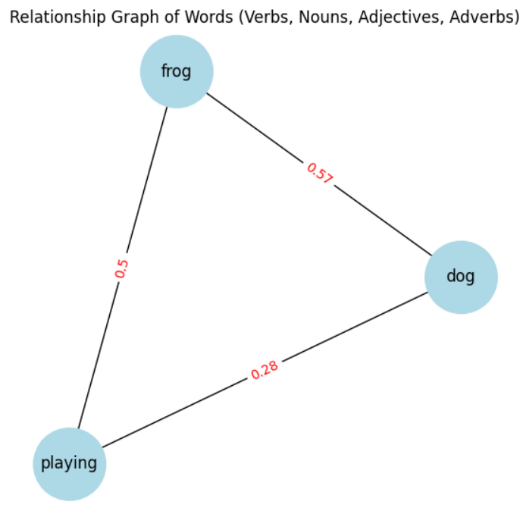
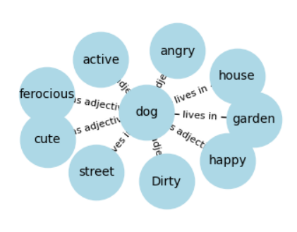
Dependency Graph
Knowledge Graph

Slide 25


Comparison [Contd.]
Generated Prompt: “ Tropical frog+++ and Cute dog+++ are playing, in the rainforests ”

Slide 26
THANK YOU

